Slide 1



Proxy VMD Modeling Project
Andrew Mertens (University of California, Berkeley)
We are grateful for the funding support by the Gates Foundation

Slide 2
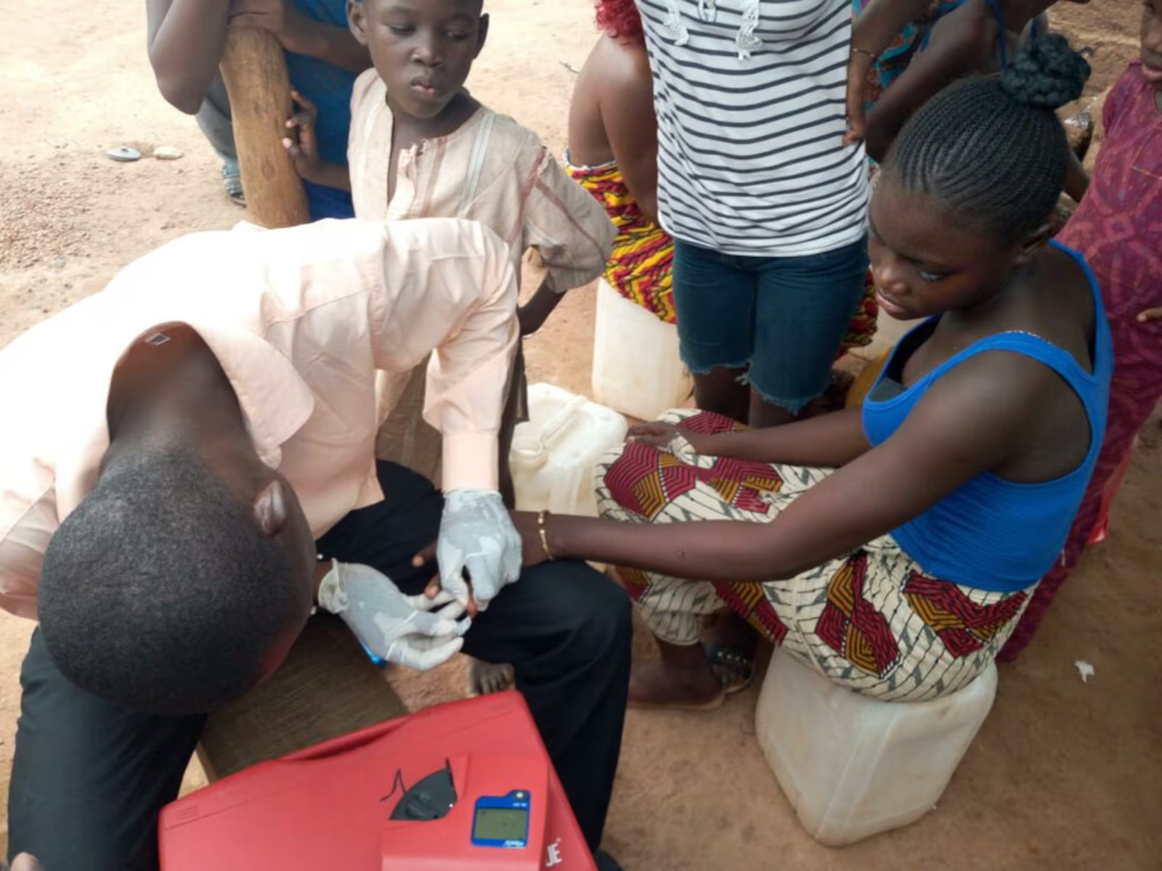
Proxy Modeling for Vitamin and Mineral Deficiencies (VMD)
Introduction
Why this project
  Biomarker surveys are rare & costly; programs need timely VMD intelligence.
  We build models that predict VMD (today: iron, vitamin A, folate, B12) from widely and regularly collected proxy measures available across sub-Saharan Africa.
How it works
  Link “ground‑truth” biomarkers to proxy indicators available in routine surveys (DHS/MICS/LSMS) and geospatial covariates.
  Train & validate machine-learning models predicting VMD
  Evaluate importance of different proxies predictors.
Motivation
  Identify useful and parsimonious sets of predictors
  Assess if national and subnational prevalence prediction is possible in areas with no or old VMD survey coverage
GMS 2017 collaborators: University of Ghana, GroundWork, Univ. of Wisconsin–Madison, KEMRI–Wellcome Trust; with UNICEF & Global Affairs Canada.
Photo Credit: Latter-day Saint Charities

Slide 3
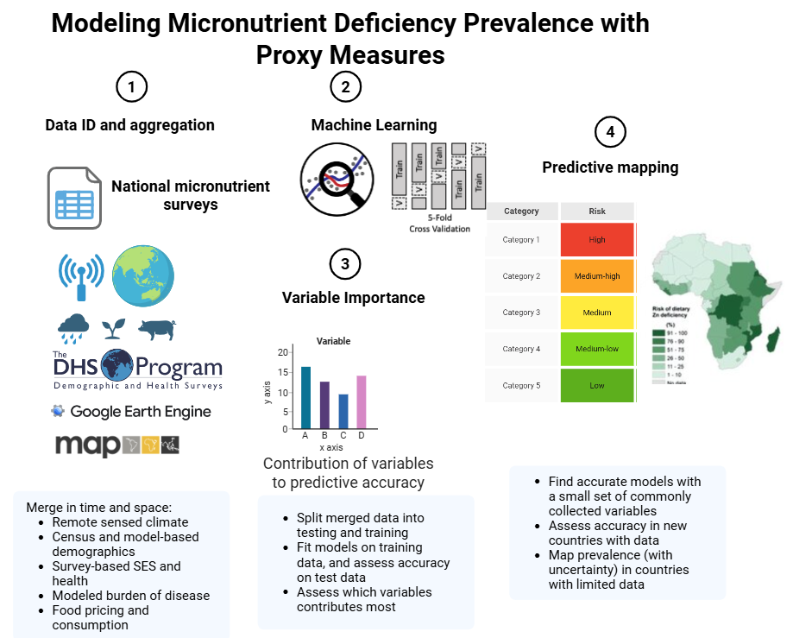

Goals
To generate national and sub-national prevalence estimates for micronutrient deficiency using a wide range of proxy indicators and validated against the prevalence of these same vitamin and mineral deficiencies (VMD) determined by biomarker assessment
To identify subnational regions at greatest risk of deficiency
To engage with national stakeholders and decision-makers throughout project

Slide 4
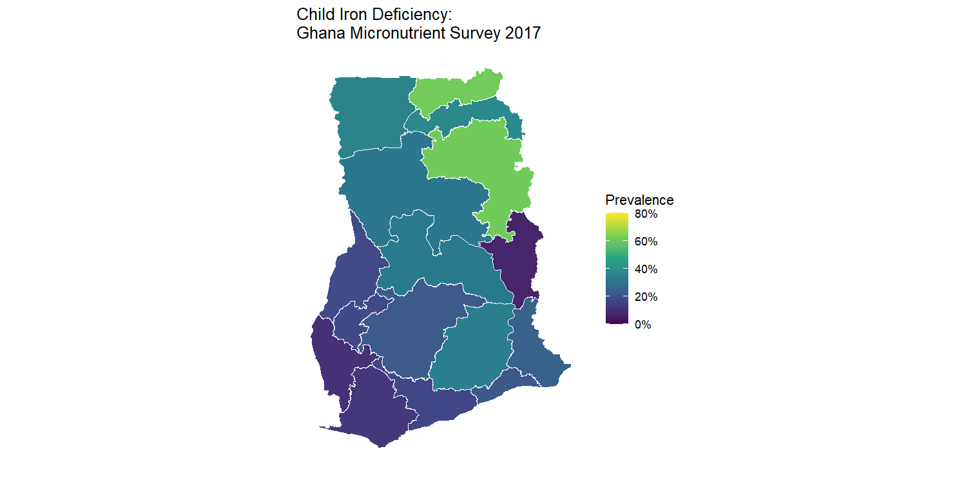
Proxy Modeling for Vitamin and Mineral Deficiencies (VMD)
Nationally-representative survey data
Four nationally representative surveys with population-based sampling and biomarker measurement, used to anchor and validate micronutrient deficiency models.
Ghana (2017) Children and women; anemia, iron, vitamin A, folate, B12; malaria and inflammation; direct measurement of fortified oil and flour.
Sierra Leone (2013) Children and women; anemia, iron, vitamin A; very high deficiency burden in a post-conflict setting.
Malawi (2015–16, DHS-linked) Children and women; anemia, iron, vitamin A, zinc, folate, B12, iodine; linkage to DHS covariates and fortification coverage.
The Gambia (2018, MICS-linked) Children and women; anemia, iron, vitamin A, iodine; quantitative salt fortification data; high anemia prevalence.
Why these surveys:
Provide gold-standard biomarker data across multiple outcomes and countries, enabling cross-country comparison, and model external validation.
GMS 2017 collaborators: University of Ghana, GroundWork, Univ. of Wisconsin–Madison, KEMRI–Wellcome Trust; with UNICEF & Global Affairs Canada.

Slide 5
VMD deficiency outcomes
Micronutrient outcome | Target population | Countries available | Biomarker / variable used | Adjustment / scale | Deficiency cutoff used
Iron status | Children 6–59 mo | Malawi, Gambia, Sierra Leone, Ghana | Serum ferritin | BRINDA-style adjustment using CRP/AGP; log scale | <12 µg/L (children)
 | Women 15–49 y | Malawi, Gambia, Sierra Leone, Ghana | Serum ferritin | BRINDA-style adjustment Inflammation-adjusted; log scale | <15 µg/L (women)
Vitamin A status | Children 6–59 mo | Malawi, Gambia, Sierra Leone, Ghana | Retinol-binding protein | BRINDA-style adjustment Inflammation-adjusted; log scale | <0.70 µmol/L
 | Women 15–49 y | Malawi, Gambia, Sierra Leone, Ghana | Retinol-binding protein | Unadjusted, log scale | <0.70 µmol/L
Zinc status | Children / Women | Malawi only | Serum zinc | Raw scale | Morning, non-fasting: <65 µg/dL (children); <66 µg/dL (women) Afternoon, non-fasting: <57 µg/dL (children); <59 µg/dL (women)
Iodine status | All | Sierra Leone only | Urinary iodine | Log scale | Non-pregnant women < 100 µg/L, Pregnant women < 150 µg
Folate status | Women 15–49 y | Sierra Leone, Ghana | Serum folate | Raw scale | < 10 nmol/L
Vitamin B12 status | Women 15–49 y (subsample) | Sierra Leone, Ghana | Serum B12 | Raw scale | < 150 pmol/L
RBP=retinol-binding protein; CRP: C‑reactive protein; AGP: α1‑acid glycoprotein

Slide 6
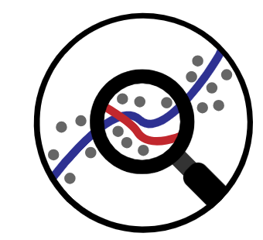


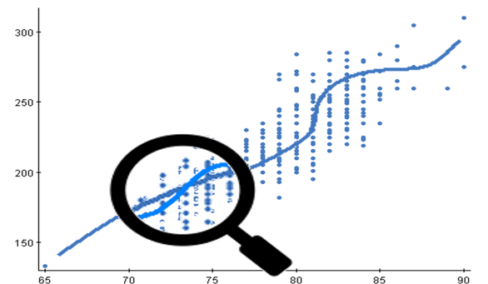
Prediction approach- Spatial Ensemble Machine Learning
Ensemble of Learners
“Competition” of algorithms
Best “team” wins
  Weighted combination of algorithms
Performance judged on independent data
  V-fold cross validation (Internal data splits) to avoid overfitting
Combinations of simple regressions and more complex machine learning models to allow interactions and nonlinear associations.
Ensemble strengths:
  Diversity
  Redundancy
  Synergy
No penalty other than computation time to add more algorithms

Slide 7
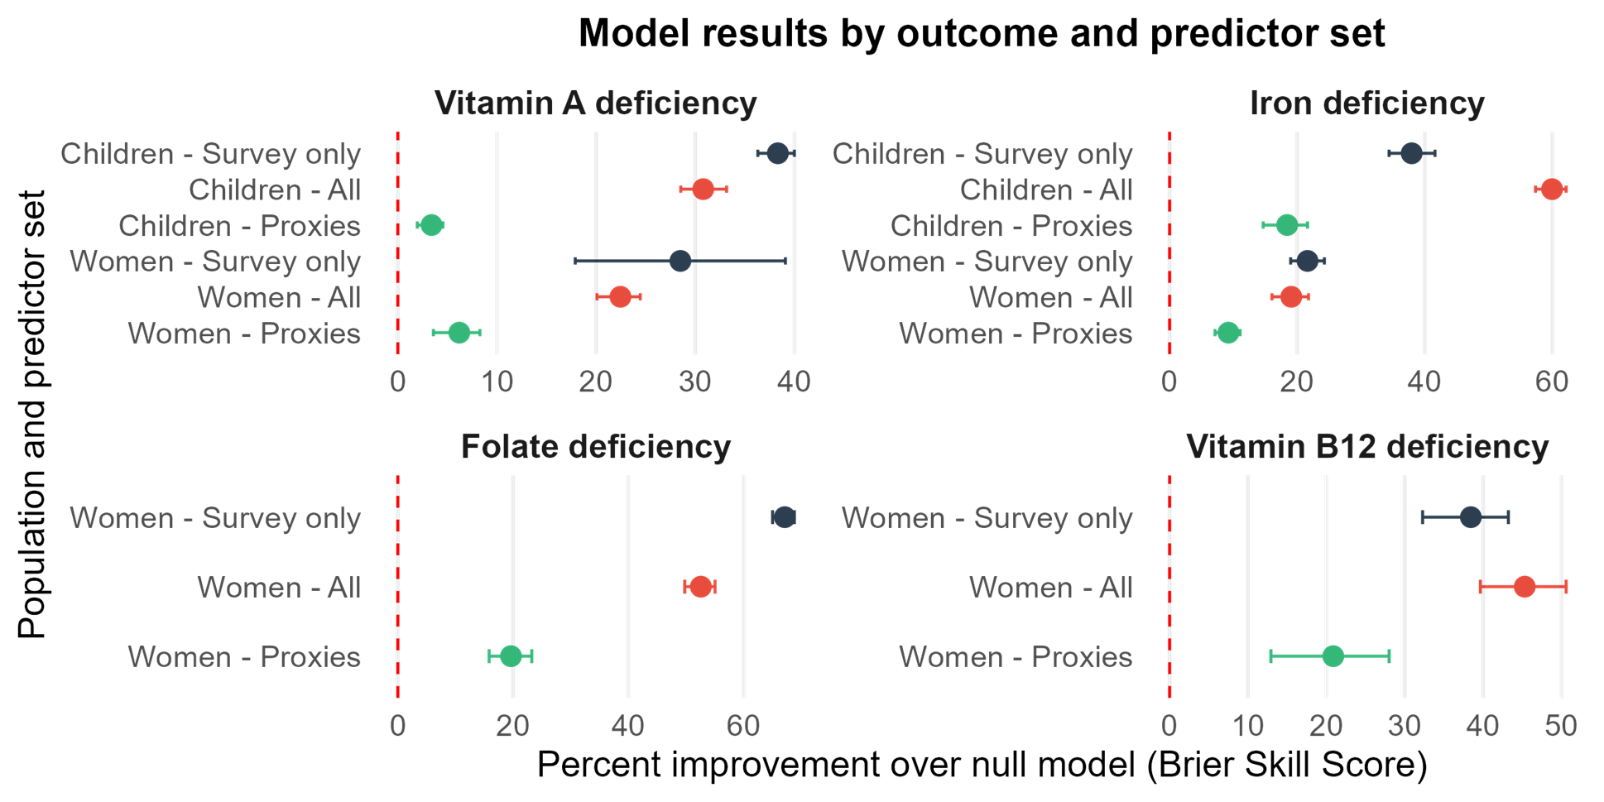
How do proxy models perform compared to using individual-level predictors?

Slide 8
What does this mean for policy?
Focusing on Vitamin B12 model’s performance
Key performance results:
Discrimination (ROC AUC): 0.689 (95% CI: 0.591–0.787)
  The model reliably distinguishes higher-risk from lower-risk women.
Targeting efficiency (Precision Recall (PR) gain): 3.09×
  The model identifies true B12 deficiency about three times more efficiently than random targeting, which is important for a rare condition.
Risk stratification (PR normalized AUC): 0.193
  The model achieves about 19% of the maximum possible improvement over random targeting in identifying true cases.
Overall accuracy of predicted risks (Brier Skill): 0.095
  Predicted probabilities reduce overall error by about 10% compared with using national prevalence alone.
Statistical confidence (Brier Skill Confidence Interval: 0.022–0.167)
The model achieves about 19% of the maximum possible improvement over random targeting in identifying true cases.

Slide 9
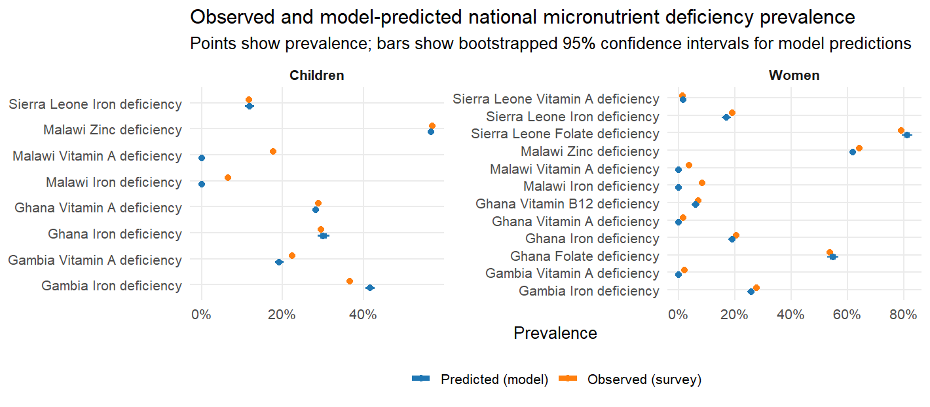
But can proxy models recover national-level prevalence estimates?

Slide 10
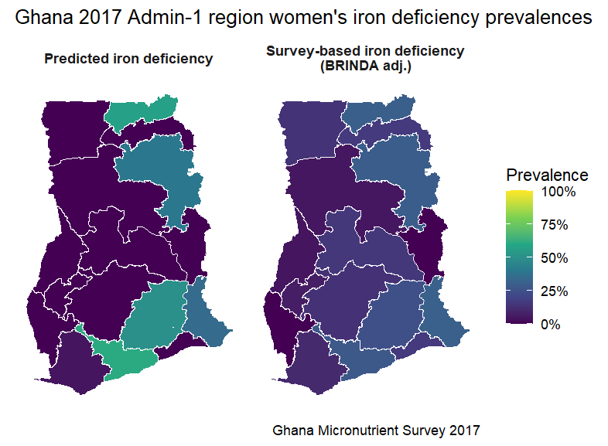
What about subnational prevalence estimates?

Slide 11
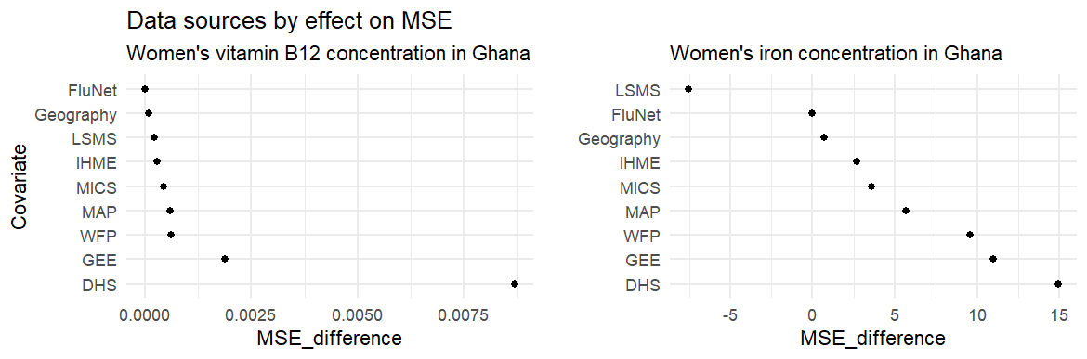
Which data sources contribute most to model prediction performance?

Slide 12
What can we learn about the consistently most important predictor domains?
Climate and agro-ecological context
Rainfall, vegetation, productivity, and temperature consistently improve prediction
Likely capture seasonality, agricultural productivity, and food system constraints
Water, sanitation, and household environment (DHS and MICS)
WASH and household characteristics show repeated positive contributions
Plausibly reflect infection exposure, inflammation pathways, and absorptive capacity
Food pricing (WFP)
Staples, legumes/oilseeds, and fruits/vegetables are repeatedly informative
Might act as macro-level proxies for diet quality and micronutrient intake potential
Disease burden and transmission ecology (Malaria Atlas Project and IHME)
Consistent with infection-driven anemia and micronutrient depletion pathways (diarrheal disease)
Reproductive and adult health context (DHS domains)
Reproductive health, family planning, and adult health domains add some signal
Likely proxy for parity, care access, and maternal physiological risk profiles

Slide 13
What can we learn about missing predictor domains?
Notable absences:
1. Direct nutrition status and intake proxies (individual-level)
DHS: Adult Nutrition (anemia, BMI, vitamin A proxy)
DHS: Child Nutrition (anthropometry, IYCF indicators)
IHME nutrition (stunting, wasting, anemia prevalence)
These variables are biologically proximal to micronutrient status but appear weak predictors once broader environmental, disease, and food system covariates are included.
Likely explanations:
  High collinearity with infection, WASH, and food availability domains
  Limited additional information at aggregated spatial scales
  Measurement error and temporal mismatch relative to biomarker outcomes
2. Education and women’s empowerment (DHS, IHME)
Strongly associated with nutrition in causal frameworks, but largely absent as top predictive domains.
Suggests their effects are mediated through:
  Household characteristics
  Food access
  Health service utilization
Once these mediators are included, education and empowerment might add little incremental predictive power.

